Slide 1

Excercise 5.3
Difference Equations: Difference equations u_{k+1} = Au_{k} move forward in a finite number of finite steps.
The solution to a difference equation u_{k+1} = Au_{k} is u_{k} = A^{k}u₀.
Every Fibonacci number is the sum of the two previous F’s:
Fibonacci equation F_{k+2} = F_{k+1}+F_{k}

Slide 2
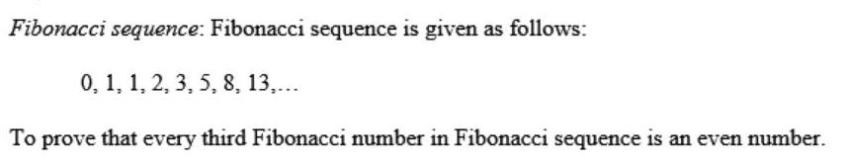
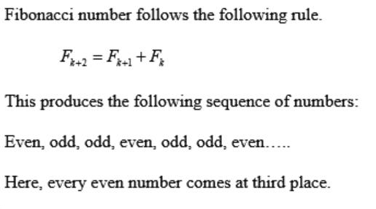
Question 1 (Solution)

Slide 3

F_{k+2} = F_{k+1}+F_{k} F_{k+1} = F_{k+1} becomes u_{k+1} =
=AU_{k}

Slide 4
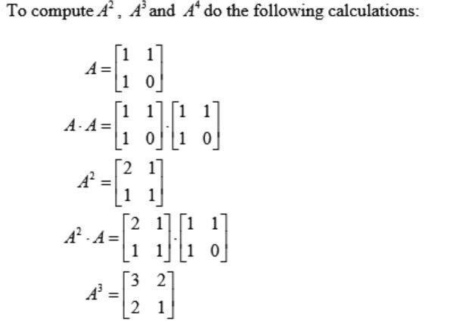
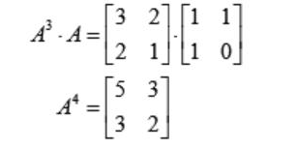
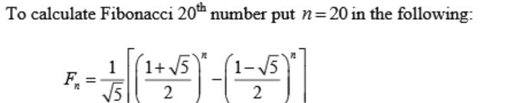
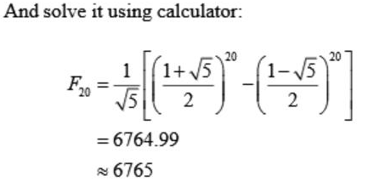
Question 3 (solution)

Slide 5
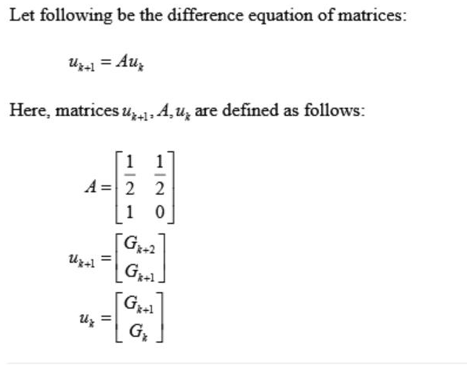
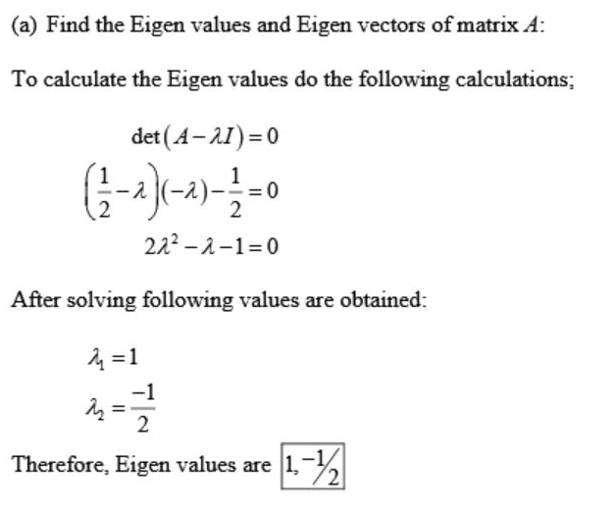
Question 4 (Solution)

Slide 6
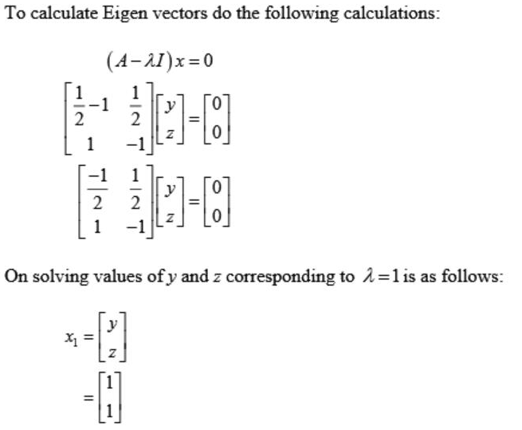

Slide 7
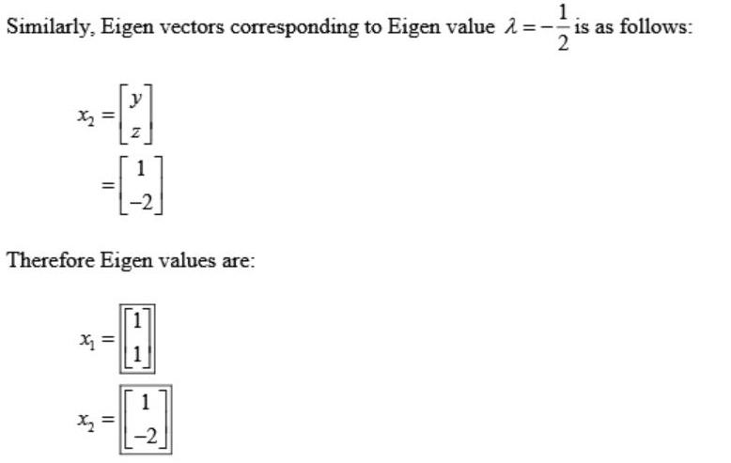

Slide 8
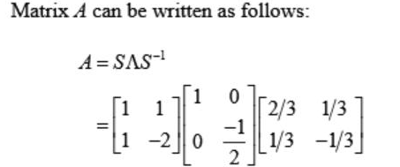
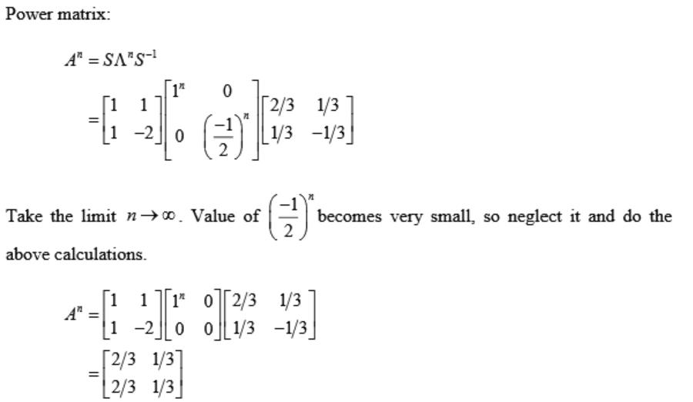

Slide 9
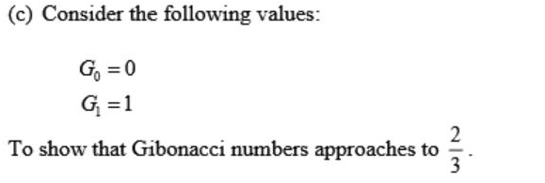
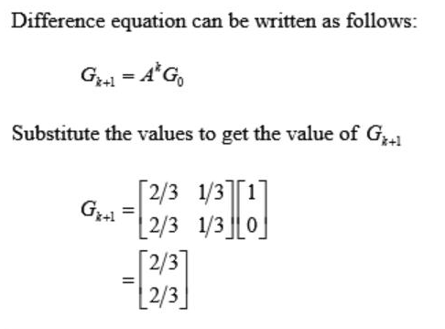


Slide 10
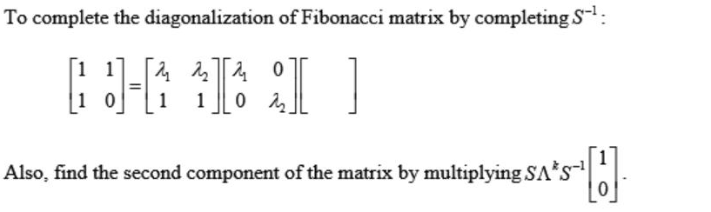
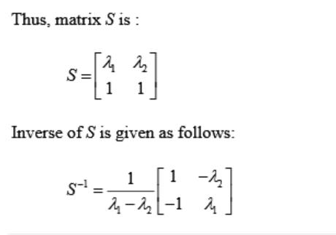
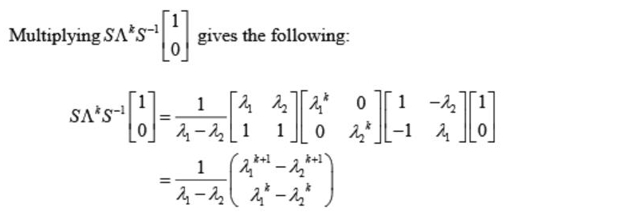
Question 5 (solution)

Slide 11


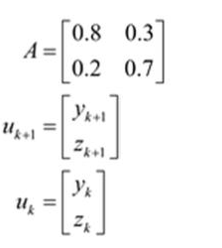
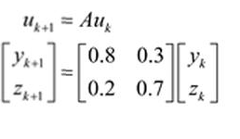
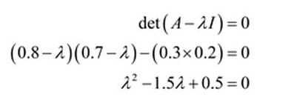

Solution Q 10

Slide 12

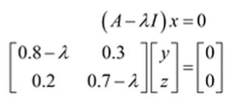
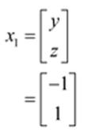

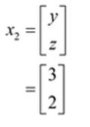

Slide 13

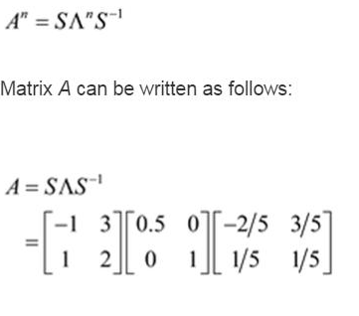
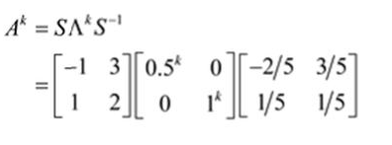

Slide 14
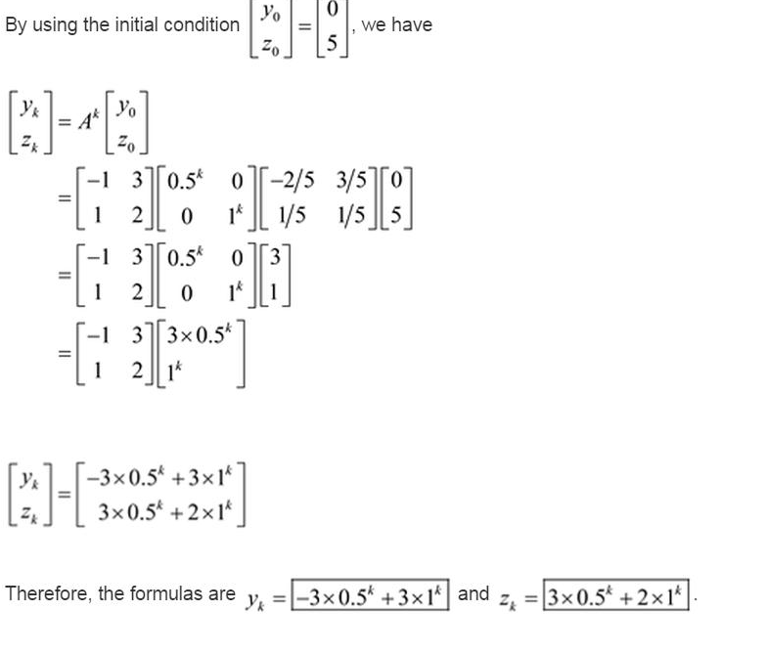

Slide 15
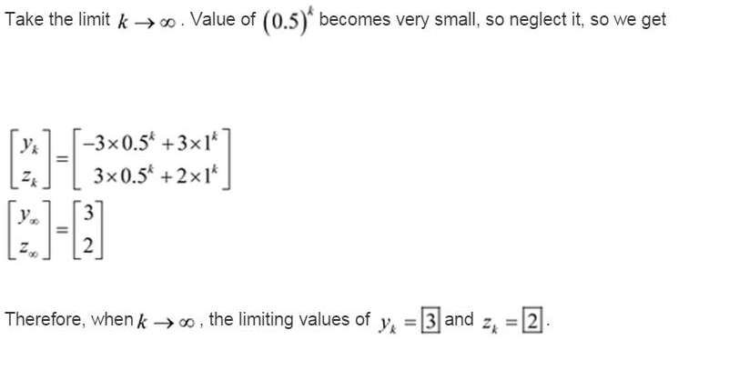

Slide 16
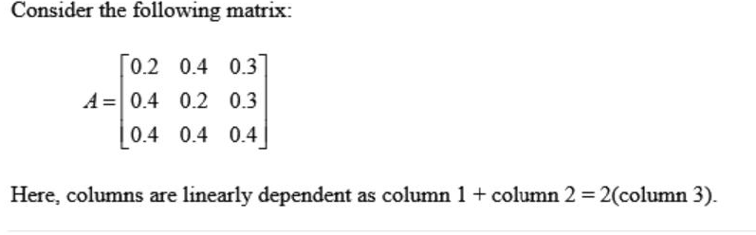
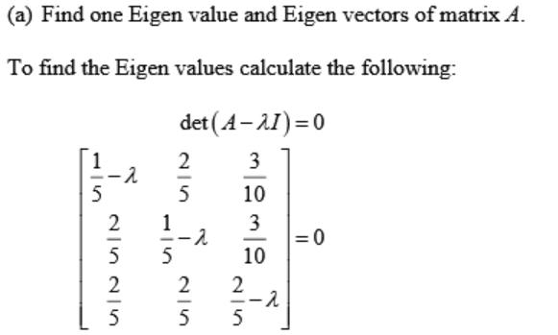
Problem 11 (Solution)

Slide 17
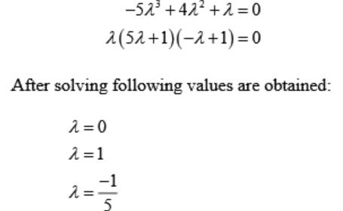
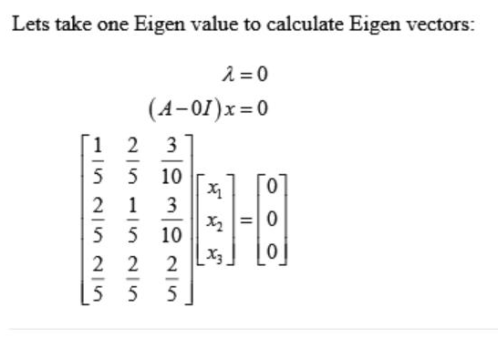

Slide 18
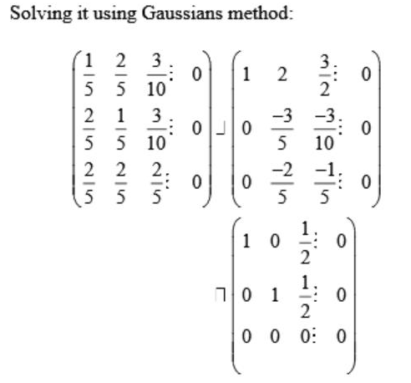
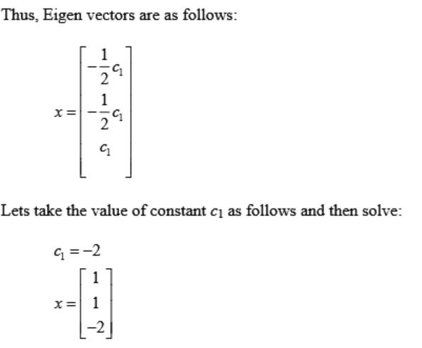

Slide 19
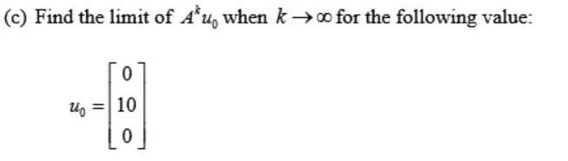
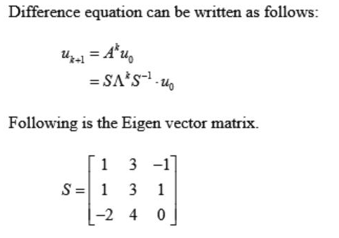

Slide 20
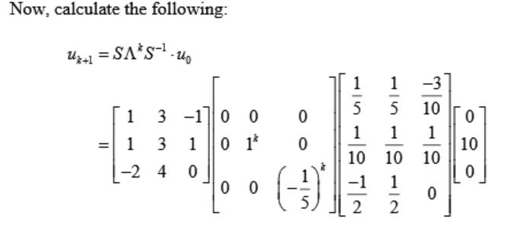
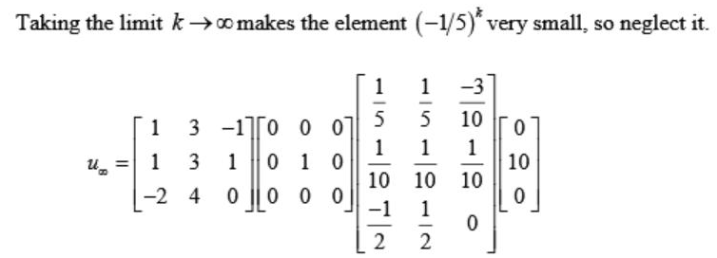

Slide 21
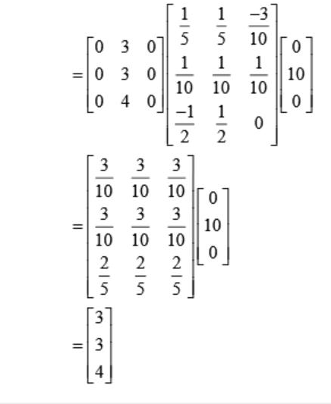

Slide 22
The difference equation u_{k+1} = Au_{k} is
stable if all eigenvalues satisfy | λ_{i} | < 1;
neutrally stable if some | λ_{i} | = 1 and all the other | λ_{i} | < 1; and
unstable if at least one eigenvalue has | λ_{i} | > 1.
The procedure to calculate the eigen values is same as we did earlier.

Slide 23
u_{k+1} = Au_{k} _{k=0, u1=Au0} _{k=1, u2=Au1=AAu0=A}²_{u0} _{Ax=b}

